Slide 1

ROTARY DISTRICT 9660 · PUBLIC IMAGE COMMITTEE
Public Image 2026-27
Online Training Webinar
Sunday 19 April 2026
Hosted by the District 9660 Public Image Committee
Notes:
Welcome everyone to the District 9660 Public Image Online Training Webinar for 2026-27. I'm Keiran Rodgers, your incoming District Public Image Chair. Thanks for joining us on a Sunday, the fact that you're here shows you care about how Rotary is seen in our communities. Over the next hour or so we'll walk through our team structure, what we do, the brand basics, and the practical tools you can use in your clubs. Please keep your cameras on if you're able and drop any questions in the chat as we go, we'll hit a dedicated Q&A near the end.

Slide 2
What Is Public Image?
The reputation Rotary holds in the mind of the public
Public image is the comprehensive perception and reputation that Rotary holds in the minds of the general public. It is formed through consistent, intentional communication, media representation, and public interactions.
1
2
3
4
Consistency
Transparency
Authenticity
Responsiveness
A clear, authentic message across every platform, social media, website, in-person.
Build trust by being open about what we do and what joining Rotary looks like.
A lasting image is rooted in genuine values, not chasing trends or performing.
Quickly addressing inquiries and feedback builds trust and shows commitment.
District 9660 Public Image Committee | Training Webinar | Sunday 19 April 2026
Notes:
Public image is basically the perception people have of Rotary, what they believe about us before they ever meet a member. It's built slowly through thousands of small interactions: a Facebook post, a news article, running into a Rotarian at the shops. These four pillars sit underneath everything we do. Miss one and the whole thing wobbles. Consistency and authenticity are the two I'd push hardest, if your club is genuine and shows up the same way every time, you're already winning.

Slide 3
Our Mission: Teach, Support, Empower
Building the capacity of every club in the district
We're not just creating content for the district. A large part of our role is teaching and supporting clubs to promote themselves effectively. When clubs succeed, the whole district benefits.
TEACH
SUPPORT
EMPOWER
Run workshops, create training videos, and build a resource library clubs can access any time.
Provide templates, offer guidance on branding, and be a resource when clubs need help.
Build club capacity so they can promote Rotary confidently in their own communities.
District 9660 Public Image Committee | Training Webinar | Sunday 19 April 2026
Notes:
These three words drive everything our committee does. Teach, because most Rotarians didn't sign up to become marketers and we shouldn't expect them to figure it out alone. Support, practical help when you need it, not lectures. Empower, the ultimate goal is for every club to run its own public image confidently. If we're still doing the work for you in two years' time, we've failed.
L

Slide 4
Your 2026-27 District PI Team
Five specialist teams. One unified goal.
Newsletter
IT Committee
Social Media
Ext Media Liaison
Video Production
LEAD
LEAD
TEAM
LEAD
TEAM
Adam & Michelle Nicholas
Cordel Murphy
Keiran Rodgers
Li Wong
Lewis Donaldson
Tahni Triffitt
Jess Kernahan
Brian Beesley
Adrian Payne
Michael Wooler
Martin McGreevy
TEAM
TEAM
TEAM
Tahni Triffitt
Keiran Rodgers
Keiran Rodgers
Burce Hemmett
Colin Shanks (AV)
Keiran Rodgers
Keiran Rodgers (PI Chair) | Cordel Murphy (IT Chair)
District 9660 Public Image Committee | Training Webinar | Sunday 19 April 2026
Notes:
Here's the team that's here to help you this year. Five specialist areas, newsletter, website, social media, branding support, and IT. Every club should know at least one person on this list they can call. If you don't know who to ask, start with me and I'll point you the right way. A big thank you to everyone who's put their hand up, this is volunteer work on top of already full lives.

Slide 5
03
SECTION THREE
Club Visits
How your PI team will work with you on the ground this year
District 9660 Public Image Committee | Training Webinar | Sunday 19 April 2026
Notes:
Moving on to club visits. Club visits are the most important thing we do as a committee, they're where we actually get to know your club, your projects, your challenges. Let's talk about what you can expect this year.

Slide 6
What a Club Visit Looks Like
On the ground with your PI team
WHY WE VISIT
Club Visit Options
Option 1: Short Visit (1–1.5 hours)
• Welcome & introductions (10 mins)
• Story audit (20 mins)
• Working session (30 mins)
• Action planning (15 mins)
Option 2: Extended Visit (2–3 hours)
• Join part of a club meeting
• Deeper dive into social media strategy
• Content planning workshop
• Training multiple members
Option 3: Hybrid Visit
• In-person visit + follow-up online session
• Allows continued support without time pressure
Listen first, help second
A club visit isn't an inspection. We come to understand how your club is telling its story, where you're getting stuck, and what practical help would make a real difference. Every visit ends with 1 to 3 concrete actions we'll follow up on.
01
Story audit
Quick review of your website, Facebook, newsletter and signage.
02
Working session
Hands-on help with whatever your club is trying to get off the ground.
03
Resource walkthrough
We show you the Brand Centre, Canva templates, and where to get help.
District 9660 Public Image Committee | Training Webinar | Sunday 19 April 2026
Notes:
Expect a friendly chat, not a clipboard exercise. We'll schedule visits quarterly by cluster, kickoff calls in the first quarter so we know everyone, in-person and online visits through the year, and follow-ups near the end. If you want a visit sooner than scheduled, just email the committee. We'd rather come too often than not enough.
L

Slide 7
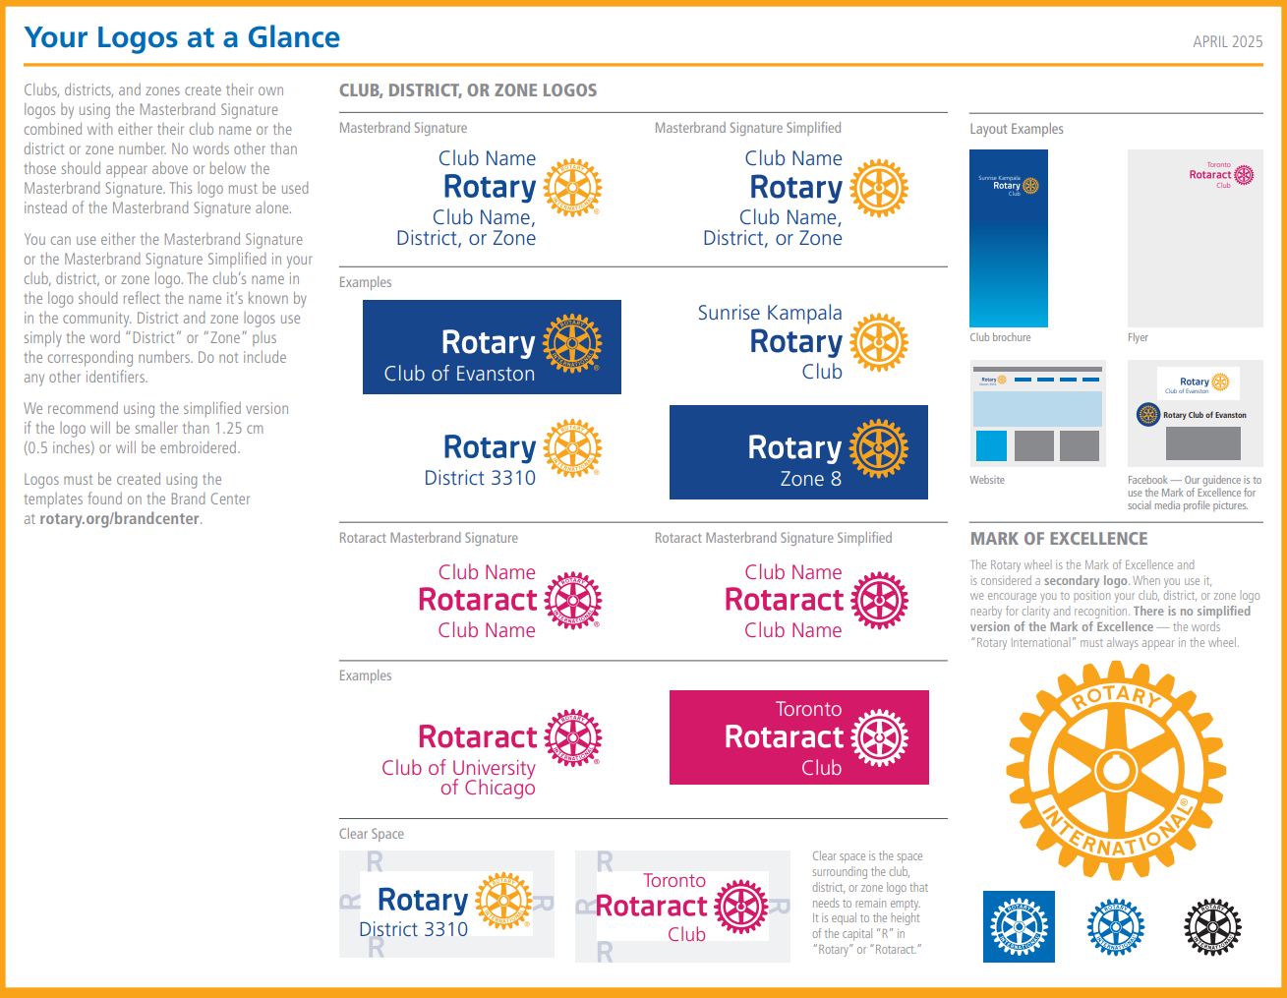
Rotary Brand Guidelines - https://brandcenter.rotary.org/
Speaking with one visual voice
Notes:
If you only remember one website from today, make it brandcenter.rotary.org. Three colours, one wheel, and a simple rule: don't reinvent it. Every club that creates its own logo or changes the blue ends up diluting something millions of hours of volunteer effort has built up. Stick to the recipe and your content instantly looks like Rotary.

Slide 8
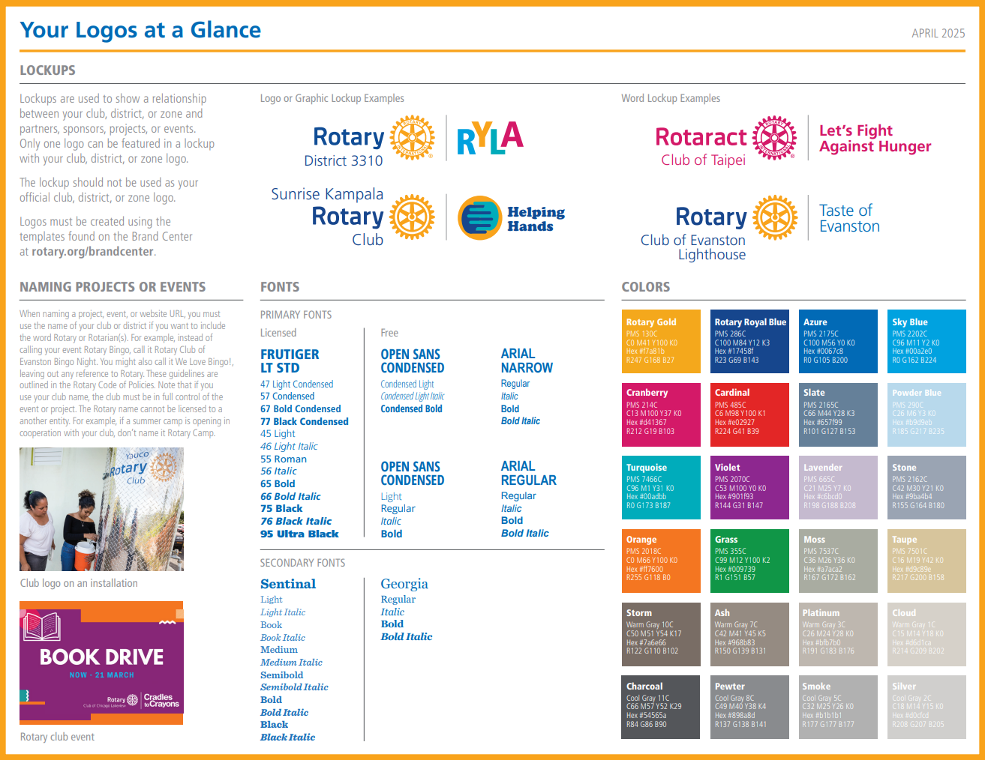
Rotary Brand Guidelines - https://brandcenter.rotary.org/
Speaking with one visual voice
Notes:
If you only remember one website from today, make it brandcenter.rotary.org. Three colours, one wheel, and a simple rule: don't reinvent it. Every club that creates its own logo or changes the blue ends up diluting something millions of hours of volunteer effort has built up. Stick to the recipe and your content instantly looks like Rotary.

Slide 9
Speaking With One Voice
Clear, credible, recognisable, every club, every post
As Rotarians we need to speak with one voice. This ensures our message is clear, credible, and recognisable across every club in our district.
1
Consistent Branding
Together, We…
Use templates and assets from Rotary's Brand Centre.
Transform
2
Consistent Language
Mentor
Use our People of Action verbs: transform, mentor, connect, inspire, fight hunger, end polio.
End Polio
3
Consistent Tone
Rotary is reliable, steady, connected, ethical.
District 9660 Public Image Committee | Training Webinar | Sunday 19 April 2026
Notes:
Speaking with one voice doesn't mean being boring or robotic, it means being recognisable. Use the Brand Centre templates. Use the People of Action verbs. Keep the tone steady, warm, and grounded. Every post your club publishes should feel like it could sit next to Rotary International's content and be at home.

Slide 10
Video & Photo Content
The raw material that powers every channel we run
We want photo and video footage from as many district events and programs as possible. Real stories from real Rotarians are the most powerful content we have.
SHORT-FORM REELS
EVENT COVERAGE & PROFESSIONAL VIDEO
Lewis Donaldson
Adrian Payne & Michael Wooller
Reels are the most effective way to reach new audiences online.
Optimised for Facebook, Instagram, LinkedIn and TikTok.
Applies trending audio, hashtags and on-brand colours.
Uses GIFs, memes and AI-generated captions.
Great for jumping on what's trending to boost engagement.
Professional video and photography at district events.
RYPEN, RYLA, Showcase events, conferences and club projects.
Rotarians on the ground capturing real stories and real impact.
Raw footage turned into polished content by the video production team.
District 9660 Public Image Committee | Training Webinar | Sunday 19 April 2026
Notes:
Two streams of video work this year. Lewis leads our short-form reels, snappy, trending, designed to reach people who'd never normally see Rotary content. Adrian and Michael handle the professional coverage at district events. If your club is running a project, a fundraiser, an induction, shoot footage on your phone and send it our way. Quantity matters at the raw stage. We'll polish it.

Slide 11
Promoting Events on Social Media
Pre-event · On the day · Post-event
PRE-EVENT
ON THE DAY
POST-EVENT
Start promoting as early as possible
Save the Date announcements
Registration open reminders
Honour sponsors before the event
Include who, what, why, when, how, contact, cost
Live social media posts and Stories
Action photos and short video clips
Behind-the-scenes content
Tag sponsors and partners
Encourage attendees to share and tag
Post photos and impact results
Thank sponsors and volunteers
Share statistics and outcomes
Summary articles for newsletter
Cross-promote with similar events
CROSS-PROMOTE: Partner with similar events (running, bike riding, walking, food), particularly within the district.
District 9660 Public Image Committee | Training Webinar | Sunday 19 April 2026
Notes:
Good event promotion breaks down into three phases and most clubs rush through the first and last. Build anticipation well before the event, weeks, not days. Capture the day itself while it's happening. And don't forget the post-event wrap, that's where you thank sponsors and start building momentum for next year. Cross-promoting with nearby events costs nothing and doubles your reach.

Slide 12
Social Media Strategy
Posting with purpose, building relationships, not just content
1
Plan with a Content Calendar
2
Engage Your Followers
3
Visual Appeal
Schedule posts in advance so your content practically runs itself.
Respond to comments and messages promptly. Build relationships through two-way conversation.
Use high-quality images and videos. Canva helps create graphics aligned with Rotary branding.
4
Shareable & Authentic Content
5
Promote Your Presence
6
Respond to DMs
Mix project updates with fun, lighthearted content. Showcase members' personalities.
Link your social accounts on your website. Use tools like Linktree. Encourage members to share.
Responding to prospective members' DMs could be the difference between gaining or losing a Rotarian.
District 9660 Public Image Committee | Training Webinar | Sunday 19 April 2026
Notes:
Six habits of good social media. None of them are complicated. The one that makes the biggest difference is engaging with comments and DMs, algorithms reward it, but more importantly, real people feel seen. A prospective member who sends your club a question and gets ignored for three weeks won't come back.

Slide 13
Social Media Calendar
Plan your content so it practically runs itself
Monday
Tuesday
Wednesday
Thursday
Friday
Weekend
Member spotlight or behind-the-scenes
Project update or service story
Repost from partner NGO or Rotary International
Fun fact, Rotary quote or awareness day
Upcoming event promo or call to action
Photo recap or community moment
Batch create
Use Canva
Schedule ahead
Track & learn
Write a week of captions in one sitting
Maintain visual consistency with templates
Use Meta Business Suite or Buffer
Review performance and refine monthly
District 9660 Public Image Committee | Training Webinar | Sunday 19 April 2026
Notes:
A simple weekly rhythm beats brilliant-but-inconsistent every time. Use this calendar as a starting point, not a rulebook, swap days around to fit your club. The four tips at the bottom are the productivity unlock: batch create one evening a week, use Canva for consistency, schedule in Meta Business Suite or Buffer, then check analytics once a month.

Slide 14
06
SECTION SIX
Websites
Your club's front door, most prospective members visit before they visit you
District 9660 Public Image Committee | Training Webinar | Sunday 19 April 2026
Notes:
Next up: websites. For most prospective members, your club's website is the first interaction they have with Rotary. If it looks neglected, they assume the club is neglected. Let's talk about what a healthy club website looks like.

Slide 15
Club Websites Done Well
DACdb, hosting options, and what every club needs
EVERY CLUB WEBSITE NEEDS
HOSTING OPTIONS
The minimum viable club site
Three paths, all supported
Meeting time, venue and contact email clearly visible
Current president and board listed
Upcoming events with dates and booking links
Recent project stories with photos
"Join us" or "Contact us" form that actually works
Rotary logo, club name and District 9660 branding
Mobile-friendly
DACdb
Built-in to DACdb. Easiest option for clubs without a webmaster.
WordPress
Maximum flexibility but requires someone comfortable with website tools. We can recommend templates.
Wix, Weebly, Squarespace, etc
Moderate learning curve. Good if you want more design control.
District 9660 Public Image Committee | Training Webinar | Sunday 19 April 2026
Notes:
Three practical things about websites. First, there's a minimum bar every club site should clear, if yours is missing meeting times or hasn't been updated in six months, that's the first job. Second, you don't need to build from scratch. DACdb gives you a club website for free if you want the easy path. Third, if your club already has someone comfortable with WordPress, brilliant, we can supply templates and brand assets. Whatever path you pick, Bruce and the website team will help.

Slide 16
Telling Your Stories & Key Resources
Share your local impact with Rotary South Pacific
Share your local projects, events and community impact stories with Rotary South Pacific. Real stories influence non-members to think: "I want to be part of something like that."
Rotary Brand Centre
Rotary South Pacific
262 images, 161 videos, People of Action templates and ready-to-use social media content.
120+ Facebook posts, 7 video suites with photos and ready-to-go social posts. Share them!
brandcenter.rotary.org
rotarysouthpacific.org
Canva Templates
Facebook: Public Image, Graphics & Ideas Hub
Create professional graphics using Rotary-branded templates. Free for nonprofits.
A resource for various Rotary public image graphics, images, ideas and other ways to use in the promotion of your Rotary club and Rotary in general.
canva.com
https://www.facebook.com/groups/1595163847383932
ALGORITHMS TIP: Platforms prioritise content with high engagement. Post consistently, respond to comments, and encourage members to interact.
District 9660 Public Image Committee | Training Webinar | Sunday 19 April 2026
Notes:
Four websites to know. Brand Centre for every image, video and template you'll ever need. Rotary South Pacific for regional content you can share locally, they do the heavy lifting and you get the credit. Canva for making it look good. And the Public Image Webinars run by RSP are the best free training out there, much better than anything I can deliver.

Slide 17
Commenting & the Four Way Test
Amplify with comments and shares, but always test first
Engaging with posts through comments and shares amplifies your club's reach. But always apply the Four Way Test before commenting publicly.
DO
Add useful information to posts
Support projects and events with enthusiasm
Share posts so a wider audience sees them
THE FOUR WAY TEST
Of the things we think, say or do…
1
Is it the TRUTH?
2
Is it FAIR to all concerned?
DON'T
Post incorrect information
Criticise other members' opinions publicly
Make public criticism of Rotary (it damages the brand)
3
Will it build GOODWILL and BETTER FRIENDSHIPS?
4
Will it be BENEFICIAL to all concerned?
District 9660 Public Image Committee | Training Webinar | Sunday 19 April 2026
Notes:
Every Rotarian knows the Four Way Test. Here's the honest bit: we don't always apply it online. A public Facebook comment reaches more people than most club bulletins ever will. If you wouldn't say it from a stage at conference, don't type it on a Rotary page. Support, amplify, encourage, and when you're about to criticise, screenshot it, sleep on it, and usually delete it.

Slide 18
Tools & Platforms
The stack we use and recommend
M
Microsoft 365
office.microsoft.com
Teams, SharePoint and OneDrive for collaboration, meetings and file storage.
H
Hyzine
hyzine.com
Interactive flipbook newsletter platform replacing DACdb PDF distribution.
B
Buffer
buffer.com
Schedule and manage social media posts across Facebook, Instagram and LinkedIn.
C
Canva
canva.com
Create professional graphics using Rotary-branded templates. Free for nonprofits.
District 9660 Public Image Committee | Training Webinar | Sunday 19 April 2026
Notes:
The committee's toolkit. Microsoft 365 for everything internal, we'll add every PI contact to the shared SharePoint. Hyzine replaces PDF newsletters with something people actually enjoy reading. Buffer for social scheduling, Canva for design. All of these have free tiers for nonprofits or are covered by the district. Ask Cordel if you can't access something.

Slide 19
Nonprofit Licensing
Free and discounted tools for every Rotary club
Your club can access premium creative and scheduling tools at no cost or heavily discounted rates. Most platforms verify your status through TechSoup Australia using your club's ABN and ACNC registration.
FREE Canva Pro
50% OFF all plans
Canva for Nonprofits
Buffer for Nonprofits
Full access to premium templates, Magic Studio, Brand Kit and unlimited storage. Normally around A$165 per user each year.
Discounted access to Essentials, Team and Agency plans for scheduling across Facebook, Instagram, LinkedIn and TikTok.
canva.com/canva-for-nonprofits
buffer.com/nonprofits
Heavily Discounted
FREE Business Basic
Claude for Nonprofits
Microsoft for Nonprofits
$8 per user, per month – minimum 2 users
Teams, SharePoint, OneDrive and web Office apps. Discounted upgrades to Standard and Premium tiers.
https://claude.com/solutions/nonprofits
microsoft.com/nonprofits
HOW TO APPLY: Register at techsoup.org.au with your ABN and ACNC details, then apply through each platform's nonprofit page.
District 9660 Public Image Committee | Training Webinar | Sunday 19 April 2026
Notes:
Quick but important slide. Your club almost certainly qualifies for free or discounted versions of the tools we've just discussed. Canva for Nonprofits gives you Canva Pro completely free, that's about 165 dollars a year per user you don't have to find. Buffer knocks 50 per cent off their paid plans. Google and Microsoft both offer free business productivity suites to registered charities. The gateway for most of these is TechSoup Australia. Register once with your club's ABN and ACNC charity registration, and you get a validation token you can reuse across multiple platforms. If your club isn't sure whether you're ACNC registered, check with your secretary or treasurer. I'm happy to walk any club through the TechSoup signup, it takes about 15 minutes. Reach out to me or the committee after today if you'd like a hand getting set up.

Slide 20
How We Can Support Your Club
Your questions answered, who to call for what
GET IN TOUCH
ASK US ABOUT
Practical help,
just a call away.
PI CHAIR
Keiran Rodgers
IT CHAIR
Cordel Murphy
Newsletter writing and distribution
Website setup, hosting and content updates
Social media strategy and content planning
Brand compliance and design guidance
Photography, videography and AV resources
DACdb and Microsoft 365 training and support
support@rotary9660.org.au
District 9660 Public Image Committee | Training Webinar | Sunday 19 April 2026
Notes:
This is probably the most useful slide in the deck, screenshot it. Left side shows what we can help with. Right side shows who to call. If you're not sure where your question lands, start with me or the PI inbox and we'll route it. We genuinely want to hear from you.

Slide 21
07
SECTION SEVEN
District Links
The bookmark bar every District 9660 Rotarian should have
District 9660 Public Image Committee | Training Webinar | Sunday 19 April 2026
Notes:
Final section before Q&A: a one-page reference of the key district links, accounts and email addresses. Take a photo of the next slide, it'll save you asking 'where is that link again?' for the next twelve months.

Slide 22
District 9660 Links & Handles
Bookmark these, you'll need them all year
WEBSITES & PORTALS
SOCIAL HANDLES
CONTACT ADDRESSES
DISTRICT SITE
FACEBOOK
PI COMMITTEE
rotary9660.org.au
RotaryDistrict9660
support@rotary9660.org.au
CLUB ADMIN
INSTAGRAM
NEWSLETTER
dacdb.com
rotary9660
newsletter@rotary9660.org.au
BRAND CENTRE
WEBMASTER
brandcenter.rotary.org
support@rotary9660.org.au
RSP CONTENT
DISTRICT GOVERNOR
rotarysouthpacific.org
districtgovenor@rotary9660.org.au
CANVA
DACDB SUPPORT
canva.com
support@rotary9660.org.au
M365 SUPPORT
GENERAL ENQUIRIES
Help.rotary9660.org.au
support@rotary9660.org.au
Take a screenshot of this slide | District 9660 Public Image Committee | Sunday 19 April 2026
Notes:
Screenshot time. Websites on the left, social handles in the middle, email addresses on the right. Follow every one of our social channels, engagement helps the algorithm and the more we're seen by non-members, the more likely they are to come to their first meeting. If any of these links aren't working or you'd like something added, email the PI Committee and we'll sort it.

Slide 23
?
OVER TO YOU
Questions &
Discussion
Drop a question in the chat or unmute and have a go.
No question is too basic. If you're wondering, so is someone else.
publicimage@rotary9660.org.au
District 9660 Public Image Committee | Training Webinar | Sunday 19 April 2026
Notes:
Open the floor. Give it a good pause, webinar silence always feels longer than it is. If nothing comes in the first thirty seconds, seed with one of your own: 'One question clubs often ask is…' and keep things moving. Budget around 10 to 15 minutes here.

Slide 24
Let's Do This Together!
Together, we're going to build an engaging, professional
public image presence that truly reflects the heart of
Rotary in District 9660.
#PeopleOfAction
District Public Image Committee 2026-27
publicimage@rotary9660.org.au
Rotary District 9660 | Service Above Self | Sunday 19 April 2026
Notes:
Thank you everyone. Seriously, thank you for spending a Sunday on this. None of what we're planning this year works without clubs and members getting behind it. We'll send out a follow-up email this week with the slides, the resources and a short survey on what you'd like next. If you remember nothing else: we're here to help, you're not on your own, and every story you tell makes Rotary stronger. Have a great rest of your Sunday.

