Slide 1
Good Governance
Presented by PDG Neville Parsons
Sunday 20 Sep 2026

Slide 2
Know your governing Legislation
Incorporated Associations for Rotary Clubs and Rotary Districts
  In NSW: The Associations Incorporation Act 2009 & Associations Incorporation Regulations 2016 – Dept Fair Trading
  https://www.nsw.gov.au/business-and-economy/incorporated-associations
Constitution and Bylaws – RI Standard Club Constitution (after each Council on Legislation & published on RI website. Current is 2025 Constitution)
Rotary International Policies and Procedures
District Policies and Procedures
The principles that apply to an association’s officers / directors are fundamentally the same as for officers and directors of companies operating under Corporations Law.

Slide 3
Club compliance
Annual Reporting requirements including preparation of Audited/ Reviewed Accounts & after member approval at AGM submit Form A-12 return to Department of Fair Trading at Service NSW
https://www.service.nsw.gov.au/transaction/lodge-an-annual-summary-of-financial-affairs-tier-1-and-2-associations
Note your Club Constitution and Bylaws for requirements for Accounts and AGM
Ensure Club has a valid & current Authority to Fundraise if required.
https://www.nsw.gov.au/money-and-taxes/charitable-fundraising/charitable-fundraising-guidelines/authority-to-fundraise-nsw

Slide 4
Charitable Fundraising
Organisations that fundraise for charitable purposes must comply with the state based legislation, regulations and the authority conditions.
If your organisation intends to fundraise for its charitable purposes, it must hold an authority to fundraise unless gross annual fundraising is $15k or less.
NSW - Dept of Fair Trading has responsibility for administering the Charitable Fundraising Act 1991 www.fairtrading.nsw.gov.au/charitable-fundraising

Slide 5
Authority to Fundraise (in NSW )
Authorities will be issued for a specific period - usually 5 years & will specify any conditions. No fees are payable for application
The information that is provided includes the authority number (CFN), legal name, and start & expiry dates of Authority, & postal address.
Complete Form CA3 Annual Return for Charitable Fundraising
https://www.nsw.gov.au/money-and-taxes/charitable-fundraising/charitable-fundraising-guidelines/reporting-requirements#toc-who-needs-to-submit-an-annual-return
NSW register of charitable fundraising organisations temporarily unavailable
The register of organisations with authority to fundraise has been temporarily removed from the Verify NSW website. To check the status of a NSW authority to fundraise, please contact charity.inquiries@customerservice.nsw.gov.au.

Slide 6
ATO – Not For Profit (NFP) Annual Declaration
The NFP self-review return is a yearly reporting requirement for non-charitable NFPs with an active ABN.
https://www.ato.gov.au/businesses-and-organisations/not-for-profit-organisations/statements-and-returns/nfp-self-review-return-reporting-requirement/nfp-self-review-return
All incorporated Clubs must complete the NFP self-review Return by 31 October each year
Failure to complete the return will potentially see the club liable for tax on its income
Return to be lodged by the Club’s Public Officer or other nominated delegate as advised to the ATO. This is not simply the NSW Dept of Fair Trading noted Public Officer. ATO would have recorded the Public Officer noted when ABN was registered unless it has been updated.

Slide 7
Main Duties of Officers
  To exercise reasonable care, skill & diligence
  To act in good faith
  To retain discretions in decisions
  To avoid conflict of interest
  Not to misuse position
  Not to misuse the entity’s information
  To seek and have all required information prior to decisions

Slide 8
Legal duties of Officers
To be honest and careful in your dealings at all times
Know what your entity is doing as you and your fellow officers are responsible
At times you will be handling other people’s money and have legislative obligations eg ATO, NSW Fair Trading, Fundraising
Make sure that the entity can pay its debts as and when they fall due – solvency test

Slide 9
Legal duties of Officers (cont)
Ensure that the entity keeps proper financial records and that you are regularly updated with financial performance details – Profit & Loss and Balance Sheet. Recommend monthly.
Act in the entity’s best interests, even if this may not be in your own personal interest
Use any information you get through your position properly and in the best interests of the entity and not for personal benefit.

Slide 10
Legal duties of Officers (cont)
Personal interests that might conflict with your duty as an officer, must be disclosed to other directors/officers & the Public Officer.
Maintain a Directors/Officers Register of Interest and regularly review and update
Disclose any specific interest at any meeting dealing with a matter related to that interest - at earliest possible time.

Slide 11
What must an Officer do
You and other officers control the entity’s business. The constitution / rules will also set out Officer’s powers and functions.
You must keep abreast and informed on what the entity is doing and how it is performing – do not rely on statements from others – see the detail eg financial reports, agendas and meeting minutes
Fully investigate the impact of any proposed action both for the entity and any other party

Slide 12
What must an Officer do (cont)
Get outside professional advice if & when you need more details to make an informed decision.
Question others about how the business is going & reconcile against formal reports.
Take an active part in Board / Committee meetings.
Ensure you commit time to understand the entity and its risks.

Slide 13
Focus on Good Governance
Follow your instincts… or as it is often stated your gut feeling
Apply the Sherron Watkin’s (Whistleblower Enron) “3 M” Test - Mentor, Media, Mother
Or Rotary’s own Guide for doing things right - The 4 Way Test

Slide 14
Critical Compliance
Ensure Constitution & Bylaws are current and applied
Ensure AGM is held and complies with Constitution
Annual Reporting requirements including preparation of Accounts & after member approval at the AGM submit required returns to Department of Fair Trading
Ensure compliance with Insurance & Youth Protection requirements
Ensure a current Authority to Fundraise if required. Failure to do so can impact Rotary Brand

Slide 15
Tips for Success
Ensure Committees are appropriately resourced
Have a Plan that is documented & endorsed by members
Ensure that members are engaged with the Plan
Have Agendas and Minutes for Board Meetings and Committee Meetings
Delegate but stay informed. Leadership is key
Keep members informed and engaged – example member subs information – The cost of being a member

Slide 16
A Time for Leadership
Subscribe and commit to the agreed Strategic Plan
Recommit to our Rotary values and engagement and service
Focus on outcomes and performance
Be a team player
Commit to ongoing self learning
Commit to the Future of Rotary
Notes:
It is the role of the club’s Rotary Information Committee to educate existing members about Rotary. Perhaps some 80% of the typical club membership knows little about the programs of Rotary and have not made the transition from just being a member of a Rotary club to becoming a truly knowledgeable and involved Rotarian.

Slide 17

Any questions?

Slide 18
Planning for Success
Alignment with RI’s Strategic Plan

Slide 19
Development of RI’s Vision Statement
Rotary’s vision statement was created with input and feedback from Rotary members, former members, Rotaractors, alumni, Youth Exchange students, Rotary staff, and the general public.
Over one million people across the world were asked to share their insights with the Strategic Planning Committee through surveys and focus groups.
The result is a statement that inspires and engages while setting the pathway for the future of our organization.
The vision was approved by the Rotary Board of Directors and Board of Trustees in June 2017.

Slide 20

Rotary International – Vision Statement
TOGETHER we see a world
where PEOPLE unite and take action
to CREATE lasting
CHANGE across the globe
in our communities and in ourselves
Vision Statement www.rotary.org/en/about-rotary

Slide 21
Development of the Action Plan
Shortly after the vision statement was adopted, the RI Strategic Planning Committee began developing Rotary’s new Action Plan.
The Committee invited reactions and input from Rotary members; over 582 people from 28 different countries participated in focus groups and interviews to provide feedback.
In June 2018, the Rotary Board of Directors and the Board of Trustees approved the strategic priorities and objectives that drive the new Action Plan.

Slide 22
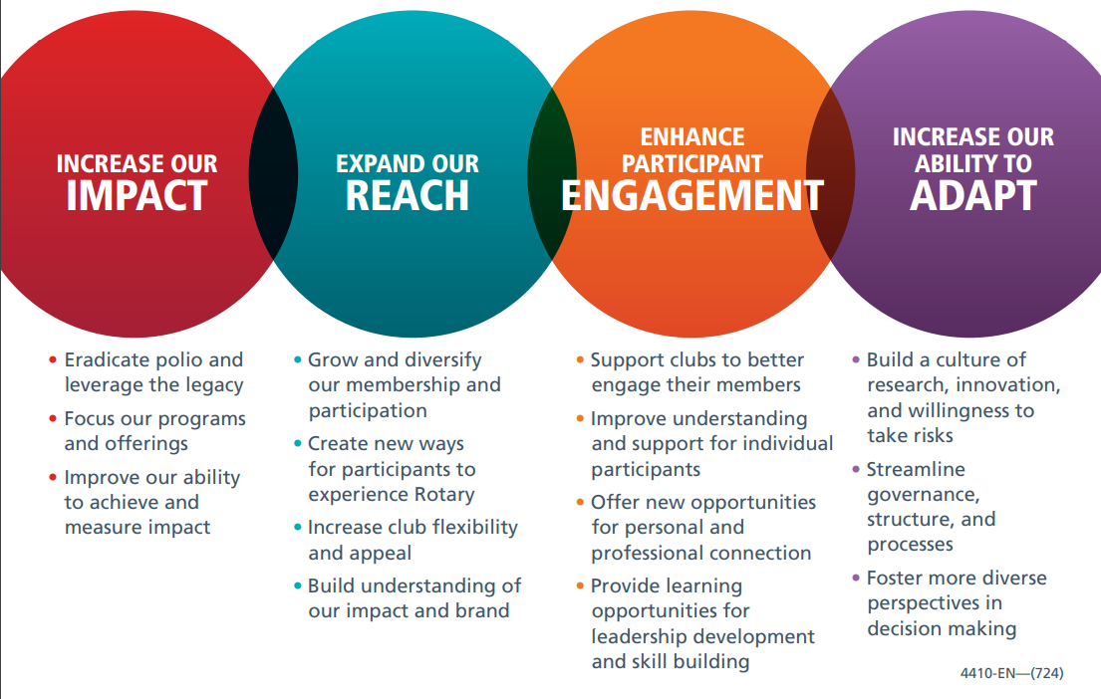
RI’s Action Plan

Slide 23
Extract from RI’s Action Plan Flyer
As we work together to build a stronger world, Rotary’s Action Plan — our strategic plan — is leading our organization to form more meaningful connections and make a more sustainable difference through service.
Using the plan’s four priorities as a guide, we’re fulfilling the vision of Rotary International and The Rotary Foundation:
creating healthy clubs
providing engaging experiences for all and
uniting people to take action with us to create lasting change.

Slide 24


Slide 25
RI’s Core Values
The values that define Rotary:
FELLOWSHIP
INTEGRITY
DIVERSITY
SERVICE
LEADERSHIP

Slide 26
Strategic Plan delivery
Plan for the Future with members and communicate that Plan
Rotary’s Values (The 4 Way Test) is the glue
The RI Strategic Plan is the Playing Field
The Object of Rotary is the Purpose
Member comfort & care, engagement and growth are the foundation stones for success
Maintain Purpose, Focus and Direction

Slide 27
Language is key
From Article 4 of the Constitution of Rotary International
The Object of Rotary is to encourage and foster the ideal of service as a basis of worthy enterprise and, in particular, to encourage and foster:
First. The development of acquaintance as an opportunity for service;
Second. High ethical standards in business and professions; the recognition of the worthiness of all useful occupations; and the dignifying of each Rotarian’s occupation as an opportunity to serve society;
Third. The application of the ideal of service in each Rotarian’s personal, business, and community life;
Fourth. The advancement of international understanding, goodwill, and peace through a world fellowship of business and professional persons united in the ideal of service.

Slide 28
The ‘Object of Rotary” as I see it
The Object of Rotary is to translate the passions of Rotarians into relevant social causes, to build better communities through:
    Care & connection
    Living the Four-way test
    Lending the hand of Service to those in need
    Tolerance, respect & understanding of all peoples of the world

Slide 29
Critical Planning Rules
Focus is key - If everything is a priority, nothing is
Communicate & Repeat the message - members must commit to changes as agreed within the Plan
Right people in place is critical for success -to carry out the priorities & deliver the Plan
Reallocate resources to drive the Plan – Resources are all aligned to the agreed strategic priorities
Encourage & seek Feedback – to ensure that Plan is delivering & meeting of the needs of all stakeholders and the agreed Vision

Slide 30
Good Governance in Strategy
Have an agreed Vision, Values and Strategic Plan (3 to 5 years)
A Plan that is well documented and communicated with all stakeholders
Aligned operational / business / annual plan (with agreed KPIs to monitor and measure outcomes)
Aligned Budget and Business Plans

Slide 31
Cowboy Logic
If you get to thinking' you're a person of some influence, try orderin' somebody else's dog around.
If you find yourself in a hole the first thing to do is stop diggin'.
Good judgement comes from experience, and a lot of that comes from bad judgment.
Always drink upstream from the herd.
When you give a lesson in meanness to a critter or a person, don't be surprised if they learn their lesson.
The quickest way to double your money is to fold it over and put it back in your pocket.
Never miss a good chance to shut up.

Slide 32
Any questions?

