Slide 1

Conflict Resolution Committee

Slide 2


Slide 3
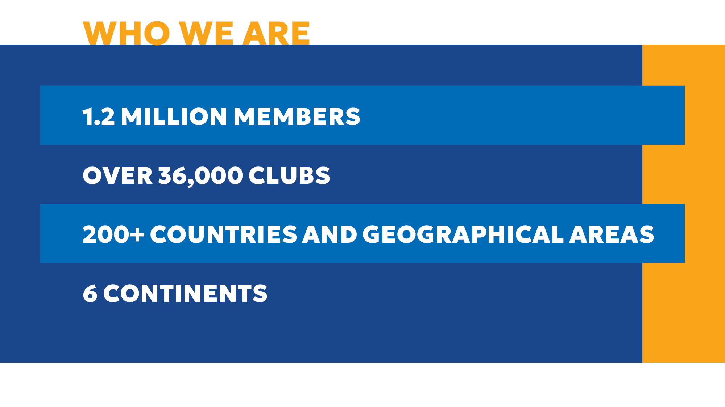

Slide 4
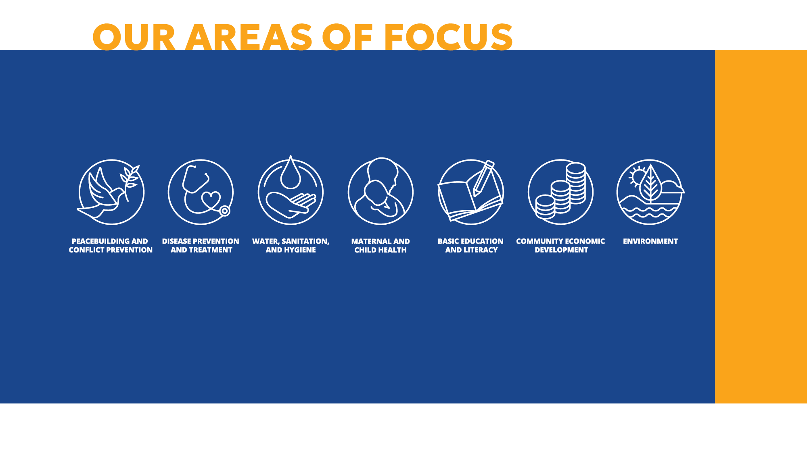

Slide 5
This is a self-guided session to help you confidently manage and respond to conflict within your club.

Slide 6
Rotary 4 Way Test
Is it the TRUTH?
Is it FAIR to all concerned?
Will it build GOODWILL and BETTER FRIENDSHIPS?
Will it be BENEFICIAL to all concerned?

Slide 7

Building Positive Culture
Strong clubs:
Communicate openly
Address issues early
Value all voices
Encourage feedback
Stay purpose-driven

Slide 8

Why this matters
Conflict happens in every club
Our response shapes culture
Healthy conflict builds stronger clubs
Poor handling leads to disengagement
Goal: Practical, simple strategies you can use immediately

Slide 9
What is conflict?
A disagreement based on needs, values, or perceptions
Often emotional, not just factual
Can lead to growth when handled well

Slide 10

Common Causes
Miscommunication
Assumptions
Differing expectations
Personality differences
Lack of clarity
Feeling unheard or disrespected

Slide 11

Rotary Specific Triggers
Leadership changes
Committee decisions
Workload imbalance
Tradition vs change
Generational differences
Service priorities

Slide 12

Early Warning Signs
Drop in attendance
Cliques forming
Tone in emails/messages
Withdrawal or silence
Frustration showing

Slide 13
Conflict Styles
Avoiding
Accommodating
Competing
Compromising
Collaborating
👉 Reflect: What’s your default?

Slide 14
Resolution at Club Level
Address early
Private conversation
Focus on issue, not person
Listen actively
Agree on next steps

Slide 15
Conversation Framework
“I’ve noticed…”
“I’m concerned about…”
“Help me understand…”
“What would a good outcome look like?”
✅ Curious, not accusatory

Slide 16
What NOT to Do
Gossip or side conversations
Email arguments
Public confrontation
Ignoring issues
Taking sides too quickly

Slide 17

Supporting people in conflict
Listen without judgement
Validate feelings
Encourage direct conversation
Stay neutral
Focus on respect
Treat all issues with confidentiality and sensitivity
Where practical consider the wellbeing of all involved
💡 Support ≠ solve

Slide 18
Everyone has a role
If you notice conflict occurring, please as a first step encourage people to talk to each other to try and resolve their concerns

Slide 19
When Leaders step in
Conflict escalates
Club function is impacted
Someone feels unsafe
Informal attempts fail

Slide 20

Ways you can support the club
Reinforce shared values
1
Model behaviour
2
Be transparent
3
Encourage inclusion
4
Keep focus on service
5

Slide 21
Practical tools
Regular check-ins
Clear roles
Agreed communication norms
“What’s working / what’s not” reviews

Slide 22
When Conflict Persists
Use mediation
Bring in district support through the conflict and resolution team
Use neutral facilitators
Focus on solutions

Slide 23
Key Messages
✔ Conflict is normal
✔ Respect is essential
✔ Early action matters
✔ Strong relationships = strong clubs
✔ Privacy needs to be respected and maintained
✔ Impartiality is essential

Slide 24
Reflection
How does our club handle conflict now?
What could we improve?
One action we will take this month?

Slide 25
Remember why you joined Rotary
Addressing conflict early and often, will lead to better conversations
Stronger clubs
Greater impact

